Slide 1
APEX PLANET DATA ANALYTICS INTERNSHIP
End-to-End Data Analytics Portfolio
Presented by: Chinni Snehitha
Apex Planet Internship | Tasks 1–4

Slide 2
INTERNSHIP JOURNEY
Objective
To analyse sales data and transform raw data into meaningful business insights through an end-to-end data analytics process.
Data → Cleaning → Analysis → Visualization → Dashboard → Statistical Validation → Business Insights → Recommendations
TASK 1
Data Cleaning & Preparation Understanding, cleaning and preparing the dataset.
TASK 2 Exploratory Data Analysis Analyzing sales patterns, products, categories, cities and customers.
TASK 3 Deep-Dive Analysis & Dashboard Creating an interactive Power BI dashboard and deriving business insights.
TASK 4 Data Storytelling & Statistical Validation Presenting findings, testing a business hypothesis and making recommendations.

Slide 3
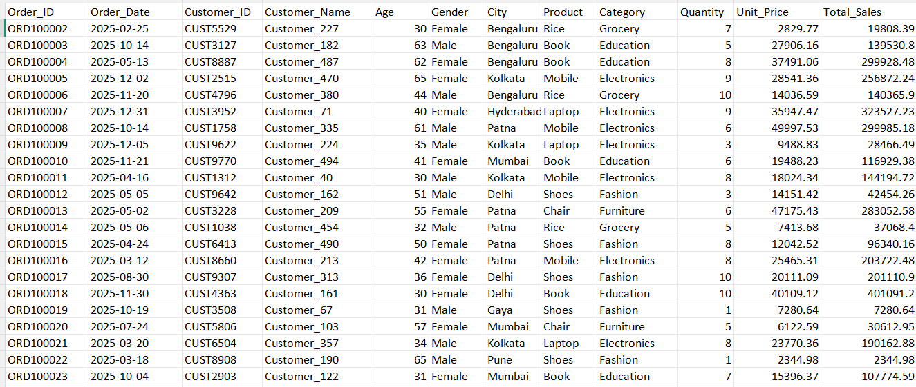
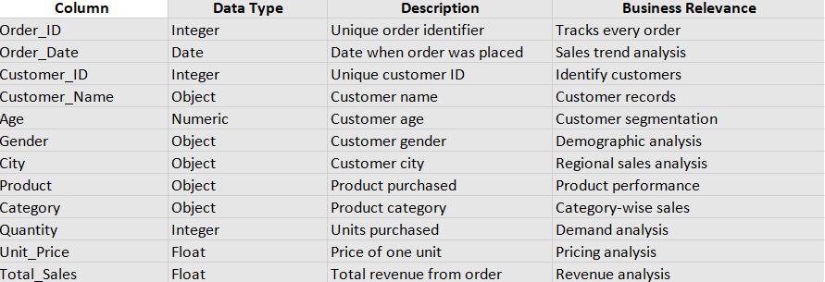
TASK 1 — DATA CLEANING & PREPARATION
Tools & Skills
Python | Pandas | Jupyter Notebook | Excel | Data Cleaning
Objective
Prepare the sales dataset for reliable analysis by understanding its structure, identifying important variables, and cleaning the data.
Key Work
Understanding the dataset
Data cleaning and preparation
Creating a data dictionary
Identifying important variables and data dimensions
Preparing the dataset for further analysis

Slide 4
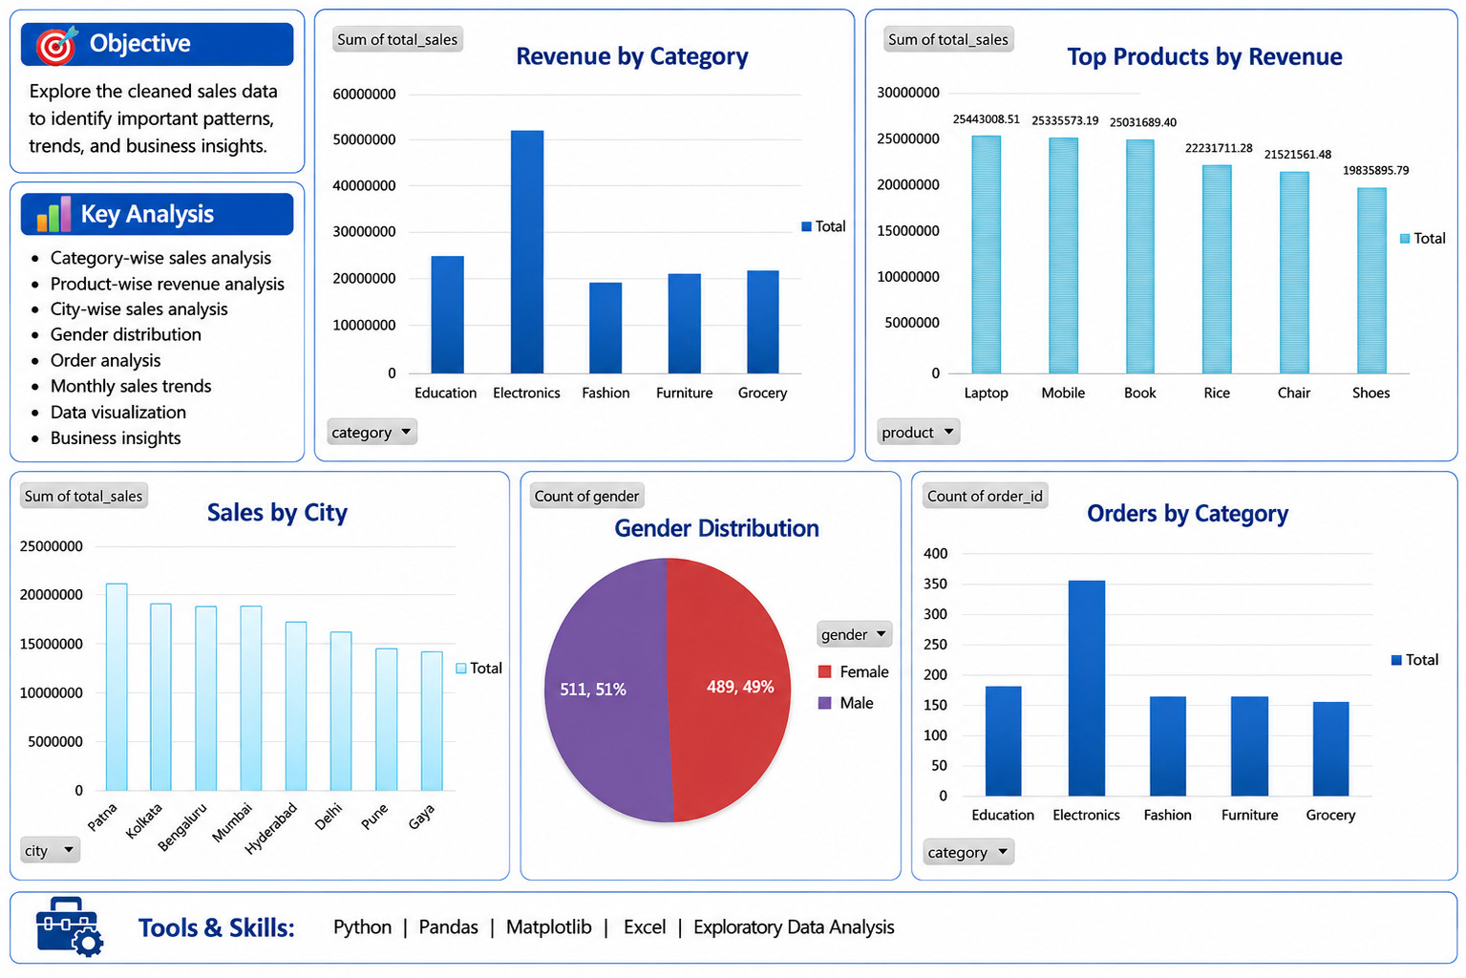
TASK 2 — EXPLORATORY DATA ANALYSIS

Slide 5
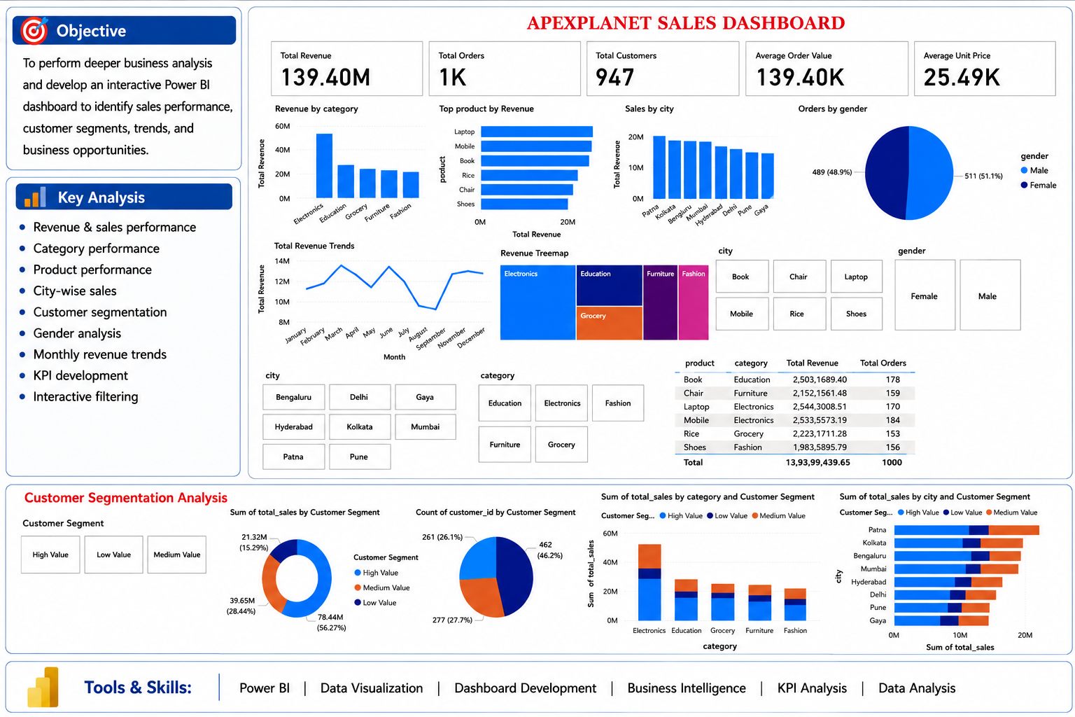
TASK 3 — DEEP-DIVE ANALYSIS & INTERACTIVE DASHBOARD

Slide 6
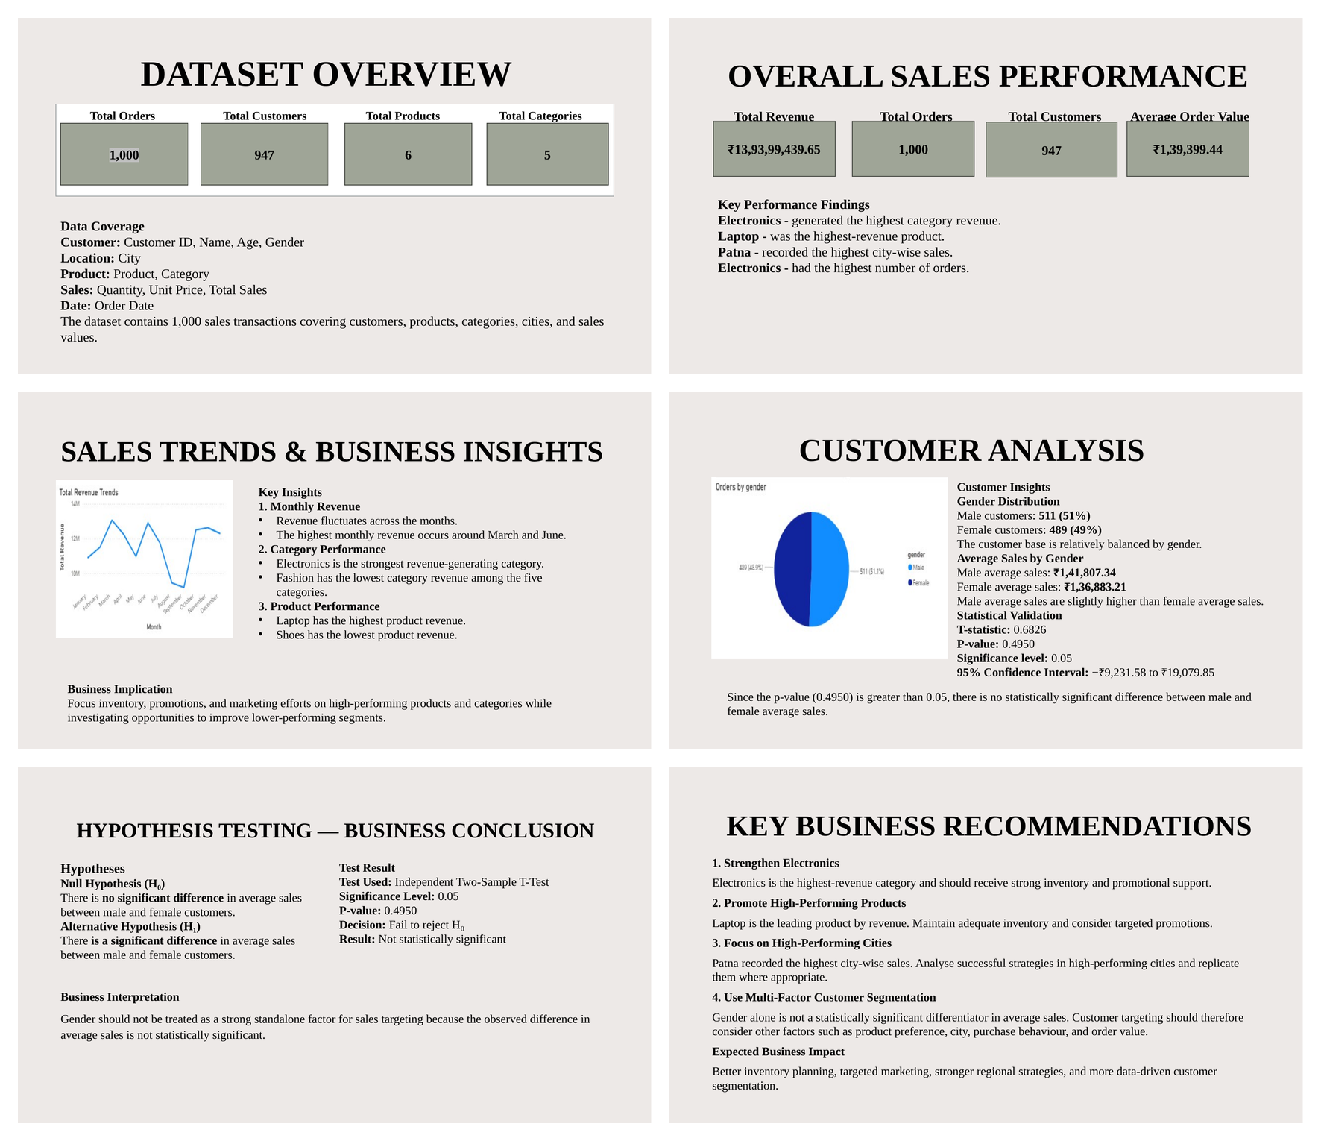
TASK 4 - DATA STORYTELLING & STATISTICAL VALIDATION

Slide 7
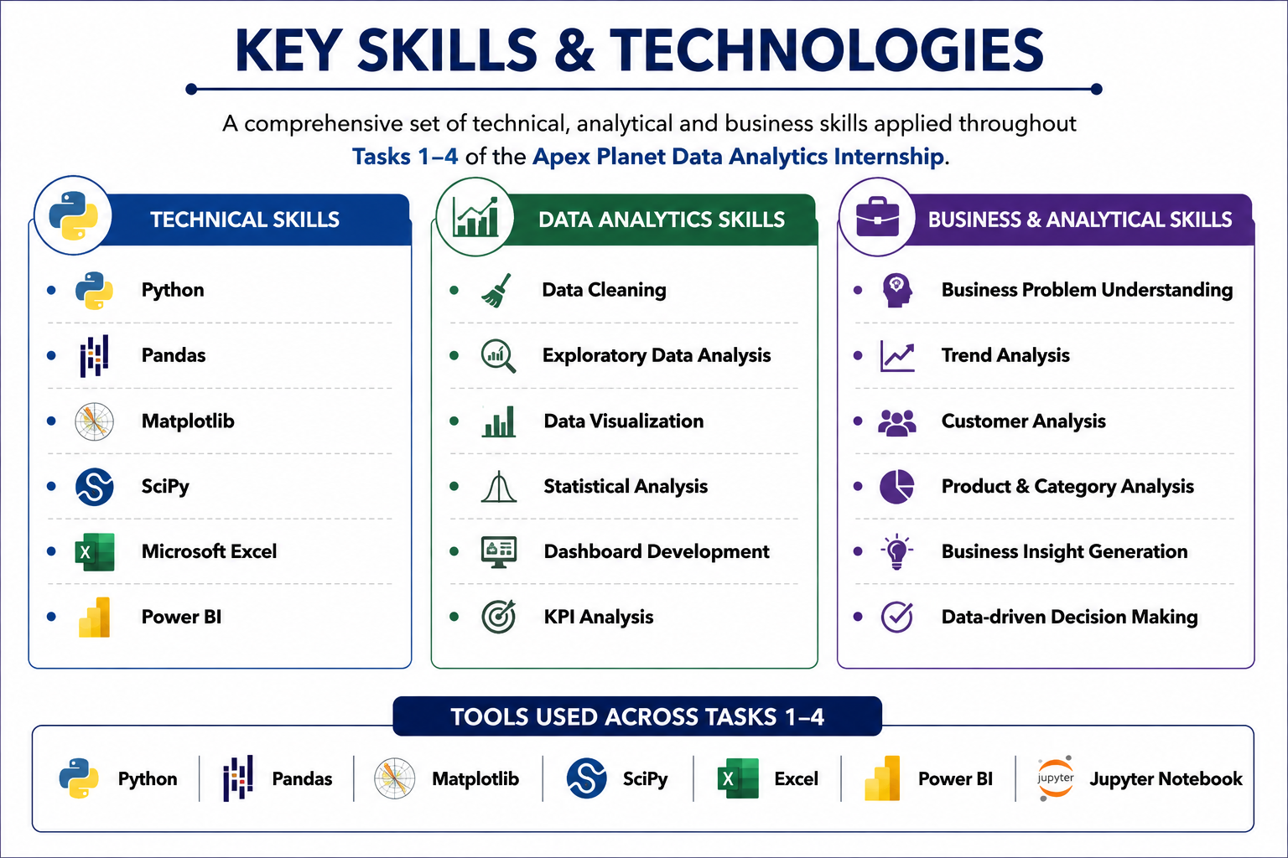

Slide 8
